Slide 1
FAOSD Programme User Instructions
Kong Cheong Tuck
FS Expert
20 – 21 October 2014

Slide 2
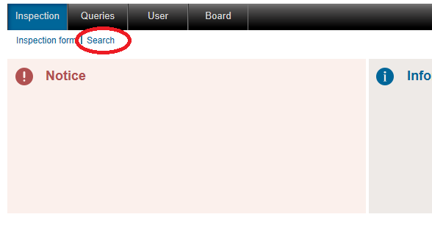
Inspection: Search
Inspection>>Search

Slide 3
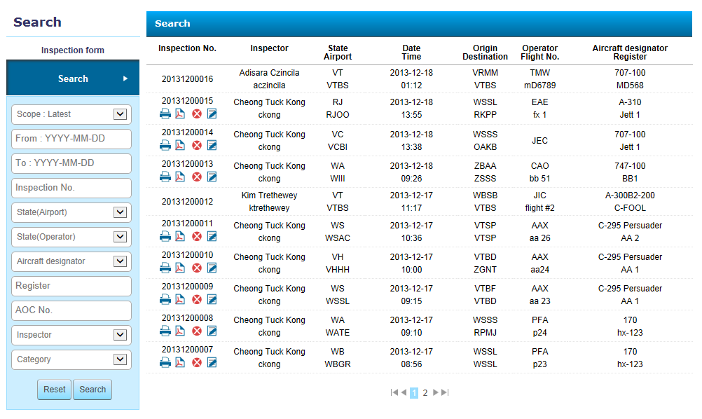
Inspection: Search

Slide 4
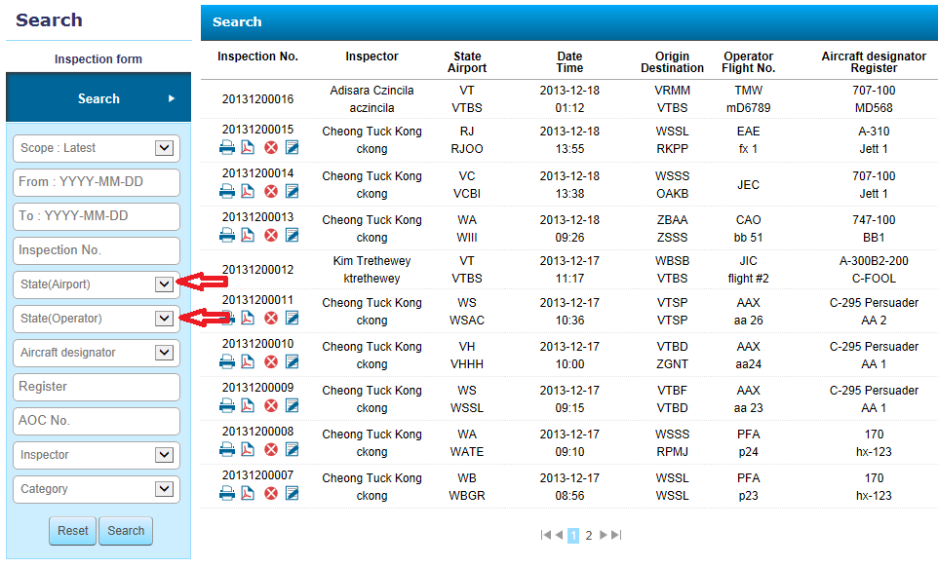
Inspection: Search
Listing of airport code.

Slide 5
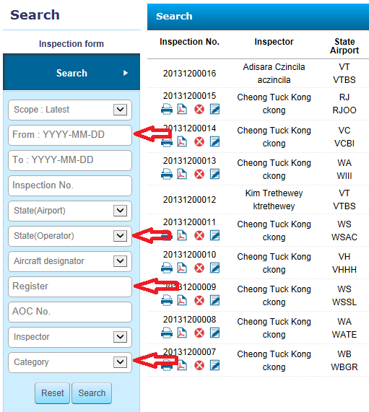
Inspection: Search
Common Search filtering

Slide 6
Inspection: Search
Thank You!
Q&A?

Slide 7
Exercise 2 – Searching the Database
Familiarise with the Search Application by using the various filtering fields:
By Period (Dates)
By name of AOC operator
By aircraft designator
By Category of findings

